Slide 1
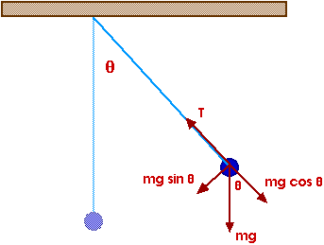
Simple Harmonic Motion
Physics 131
Lecture 12
The restoring force F = -kx
Amplitude, period, frequency and angular frequency.
Equations of SHM for x, v, a, A and φ
Circle of reference
Phasor
Energy in SHM
All found in Young and Freedman, University Physics, chapter 13, section 1, 2 and 3
Notes:
Today we’re going to look at simple harmonic motion. Simple harmonic motion is a special kind of oscillatory motion or periodic motion and a very usefull one. By oscillatory I mean that it is motion that repeats itself over and over, like the ticking of a clock, the swinging of a swing or pendulum. Periodic and oscillatory mean the same thing in this case. It can be used and combined to describe many oscillatory motions, such as the swinging of a pendulum, the sound vibrations produced by a clarinet or the back and forth motions of the pistons in a car engine. It is also useful at an atomic level when looking at the vibrations of atoms in molecules. You’ll also come into contact with it in electronics (eg ac circuits).
Here’s a list of what you need to know from this lecture. You have this information on the handout I have given you. The handout also includes the text book references.

Slide 2

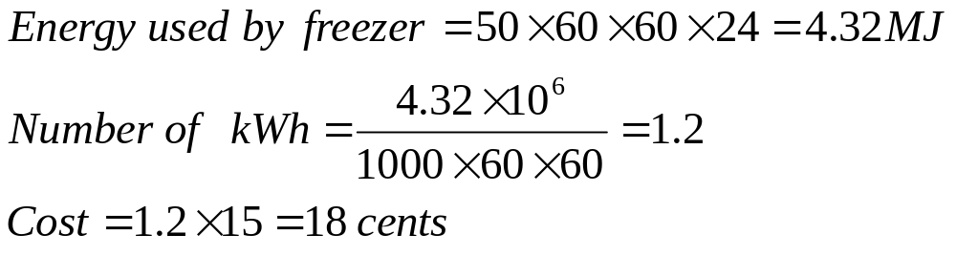
Review: Cost of electricity
What would it cost to run a freezer for a day if it uses an average of 50 W and 1 kWh costs 15c.

Slide 3
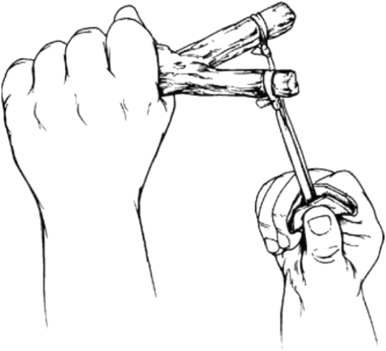
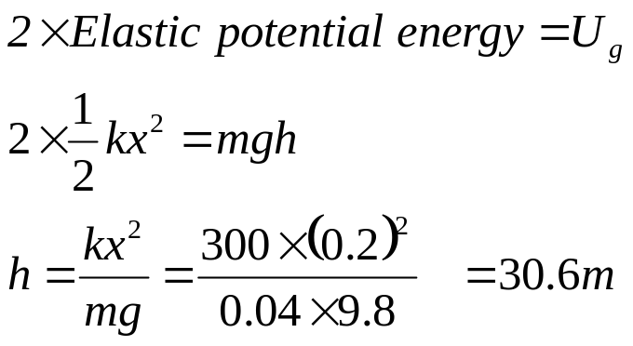
Potential elastic energy to potential energy of height
A 40 g marble is fired from a sling shot with elastic that obeys Hooke’s law is fired vertically upward. If the elastic has a spring constant of 300 N/m, and the elastic is stretched by a distance of 20 cm. How high will it project the marble.

Slide 4
SHM is…
A Harmonic oscillator is a system which, when displaced from its equilibrium position, experiences a restoring force F proportional to the displacement x:
  F = -k x
where k is a positive constant.
If F is the only force acting on the system, the system is called a simple harmonic oscillator, and it undergoes simple harmonic motion: sinusoidal oscillations about the equilibrium point, with a constant amplitude and a constant frequency.

Slide 5
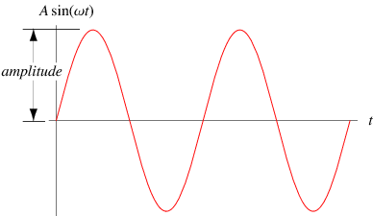

Amplitude
Amplitude A, is the magnitude of the maximum displacement from equilibrium.
The perfect storm- a large amplitude wave
Notes:
There are a number of terms we can use to describe this periodic motion that help us to measure it.
Amplitude, A, is the magnitude of the maximum displacement from equilibrium. It is measured in metres. So for the example I gave it is the distance we pulled the mass to, which it then goes to in the –ve direction and then back, never extending beyond this. A is always +ve. In our case it is 10 cm. Note it is not 20 cm (distance from one extension to the other). It is the max displacement from x=0. In a wave you know this as the max height or depth of the wave from the undisturbed position (DRAW)
Infact we can draw displacement as a function of time like this. If we displace it 10 cm then let go you get something like this (DRAW x vs t with x(0) at 10 cm)

Slide 6
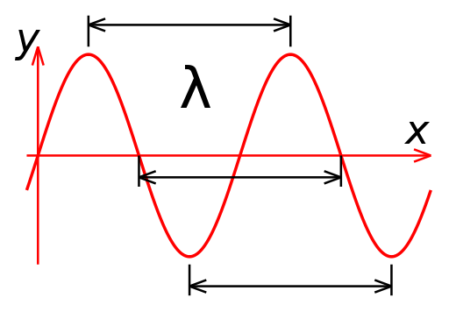
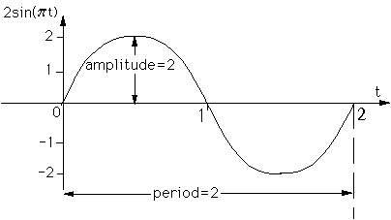
Period of wave
Wavelength of wave
Period, T, is the time for one cycle of displacement to occur
Wavelength is distance for one cycle to occur.
Notes:
Period, T, is the time for one cycle of displacement to occur. It is measured in seconds per cycle.This means it is the time it takes for our mass to go from +10cm to –10cm and then back again to + 10 cm.
In a wave you know this as the time between whole wavelengths (DRAW)

Slide 7
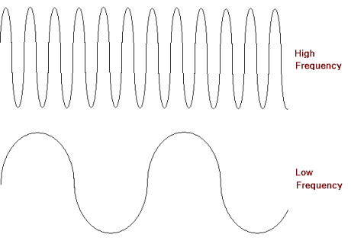
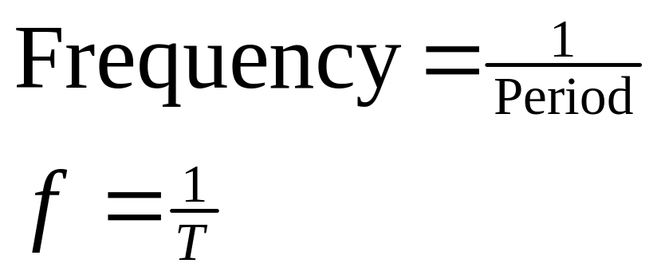
Relationship between
Frequency f & Period T
time
Frequency is a measure of how often
a wave repeats in one second.
Notes:
Waves have a frequency…. A measure of often a wave beats in one second.
The frequency is inversely proportional to the period…. The time that it takes for the wave to complete one wavelength- ie the time that it takes for the wave to start repeating.
Heres an example….
Waves on the ocean hit a wharf pole every 8 seconds…. Is 8 seconds the period or frequency?
What is the frequency?

Slide 8
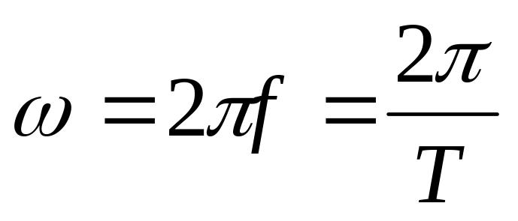
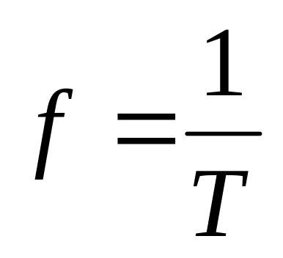
Amplitude, period, frequency, angular frequency and their interrelation
Angular velocity, ω, is 2π times the frequency
π/2
π
0,2π
3π/2
Notes:
Angular frequency, ω, is 2π times the frequency. It represents the rate of change of an angular quantity
Its units are rad/s. We’ll see how it fits in later.
Frequency = 1/period, so period = 1/freq, and if put these into omega get omega = 2 pi/T
A simple example question – A body attached to a spring is displaced 0.12 m from its equilibrium position and released with zero initial velocity. After 0.8 s its displacement is found to be 0.12 m on the opposite side, having passed the equilibrium position only once. Find the amplitude, period and frequency of this periodic motion.
Its initial displacement is A as cannot go further than this. It starts at 0.12 m on one side then goes to 0.12 m on the other side. So A = 0.12 m. Period….well took 0.8 s to go from one end to the other so 0.8 s to get back therefore period for one complete cycle is 0.8 *2 = 1.6 s. Frequency = 1/period = 1/1.6 = 0.625 Hz.

Slide 9
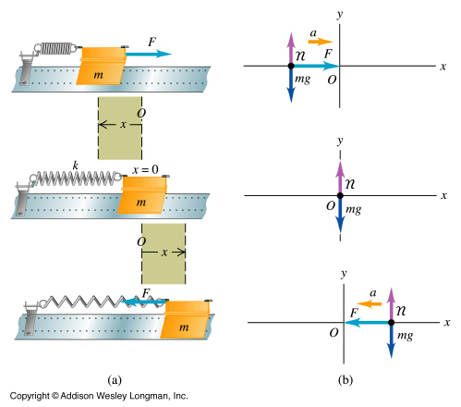
Oscillatory Motion and restoring force
F= - k x
Have velocity when x=0 so overshoots
Notes:
Simple Harmonic motion occurs when the restoring force is proportional to the displacement from equilibrium x. This happens if the spring is ideal and obeys Hookes Law.
Compress spring…. Mvoe to the left….. Have a restoring force towards the right…
At x=0 …. No horizontal force
Can extend spring..have restoring force towards the left…..

Slide 10
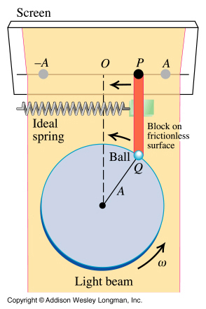
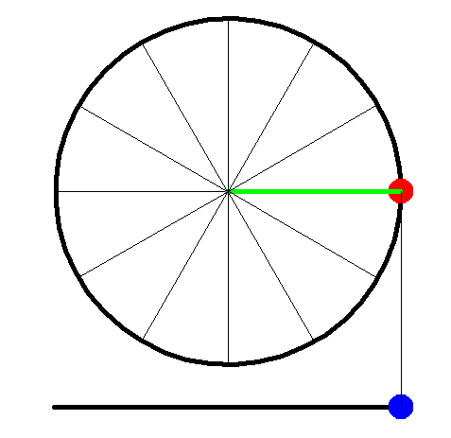
Circle of reference and the Phasor
SHM is the projection of uniform circular motion onto a diameter.
The circle in which the ball moves so that its projection matches the motion of the oscillating body is called the circle of reference.
The vector joining the centre of the disk with Q rotates as the disk rotates and is called a phasor – a vector rotating with constant angular speed.
Notes:
Here is a simple machine that creates simple harmonic motion.
A ball rotating on a string, with a light shone on it.
The shaddow cast on the screen exhibits SHM on the screen.
This shows that SHM is the projection of uniform circular motion onto a diameter. The circle in which the ball moves so that its projection matches the motion of the oscillating body is called the circle of reference. The line joining the centre of the disk and the point Q where the ball is attached will rotate with the same angular speed as the ball. Such a rotating vector is called a phasor.
@
If we look at trig functions
Costheta would describe the position…
Sin theta would describe the velocity… max when x = 0
-cos theta would be the acceleration- opposite x….. Displacement.

Slide 11
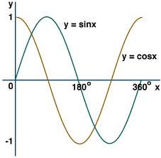
Sin or cos curves – only difference is phase. Other than that same curve

Slide 12
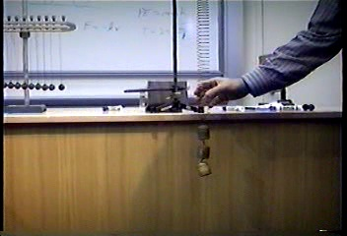
Notes:
Simple harmonic motion
Hookes law- retoring force

Slide 13


Slide 14


Slide 15
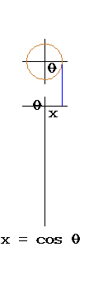
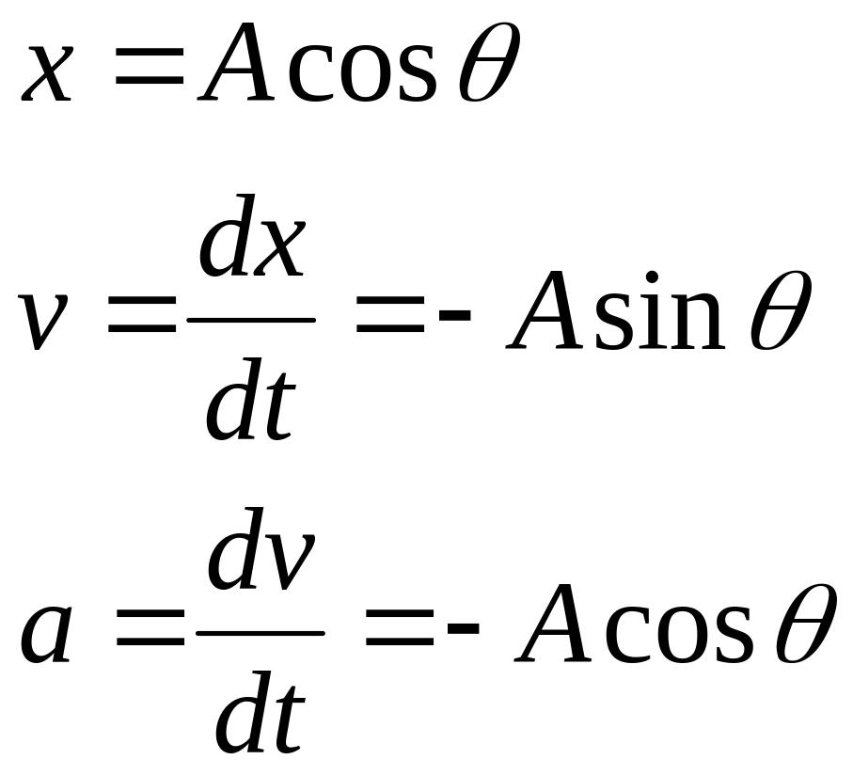
Equations of SHM for x, v, a
Differential of cosθ = -sinθ
Integral of cosθ = sinθ
Differential of sinθ = cosθ
Integral of sinθ = -cosθ
Notes:
So what about those equations ? Well we can look at the phasor OQ in this diagram and see its projection in x. It is x=Acos theta.

Slide 16
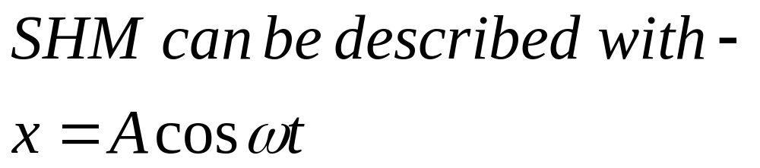
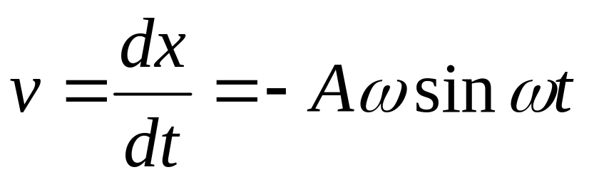
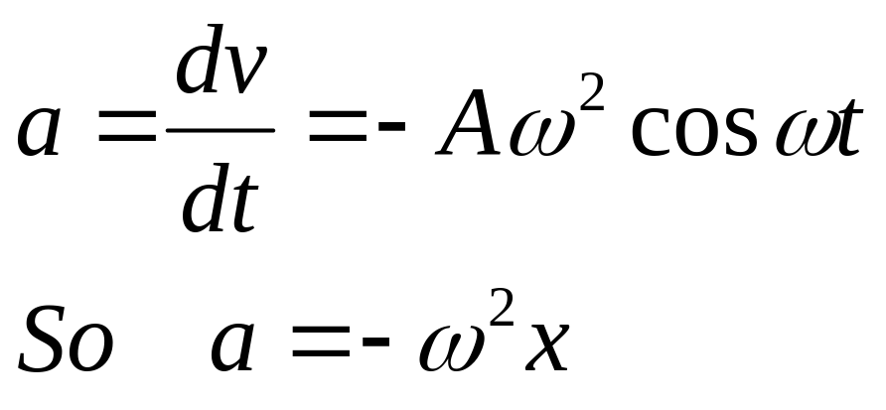
Change θ to ωt ?
Differential of cos(f(x)) = -f’(x)sin(f(x))
Differential
Differential of cosωt = -ωsinωt
Notes:
Wt is the same as writing theta.
Differentiate to obtain a

Slide 17
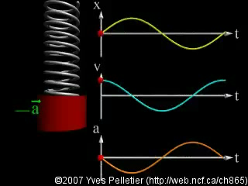

Slide 18
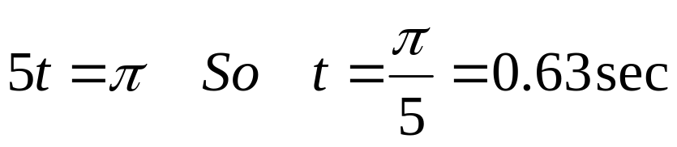
Example: Position in SHM
A particle is oscillating in SHM according the equation x = 6cos5t - in metres
What position will it have at t = 0
What will be its position at time t = 8 seconds?
When will be the first time it reaches minimum position?
Maximum = 6 m
x = -6 x 0.667 = - 4.0 m

Slide 19
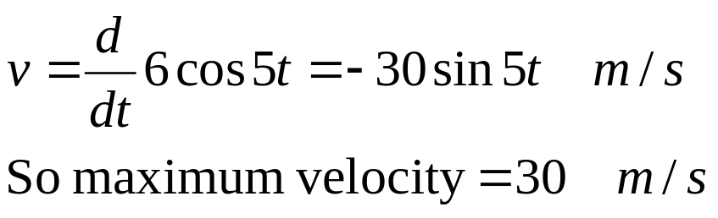
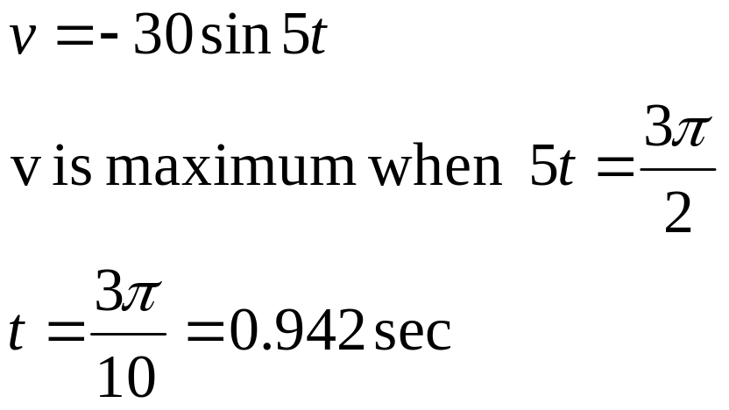
Example: Velocity in SHM
Given that the position of a particle follows the equation x = 6cos5t in metres, find the maximum velocity of the particle, and the first time this occurs.

Slide 20
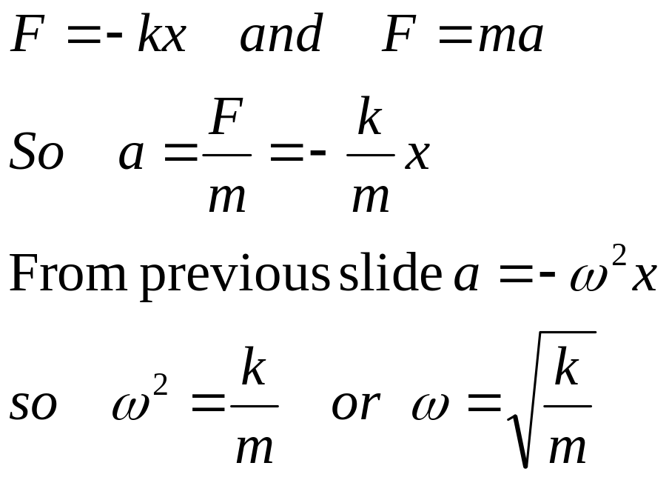
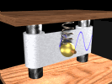
Simple Harmonic Motion (SHM) is periodic motion where the restoring force is directly proportional to the displacement from equilibrium
Notes:
So what’s so special about SHM ? Well it is periodic motion where the restoring force is directly proportional to the displacement from equilibrium.
The example we’ve been looking at is SHM. We had a spring exerting the force. What was the force exerted ON the spring, do you remember ? F=kx.
Since we know F and from newton’s 2nd law, F=ma, we can see that a is given by the equation shown. Note that the accn is not constant so we cannot use those equations for motion that we derived for constant accn. We’ve got to find another way of describing the motion.
Omega related to k is quite handy – different springs have different spring constants
Higher spring constant = higher omega = higher freq
Lower spring constant = lower omega = lower freq

Slide 21

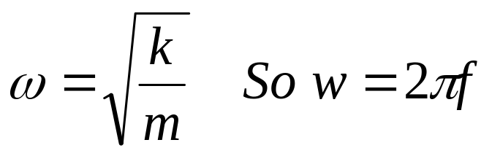
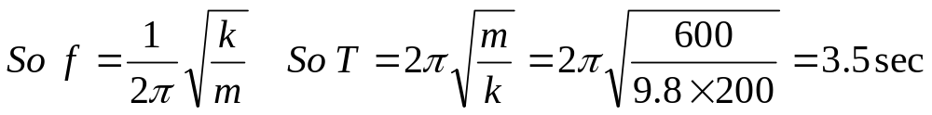
Ben the Bungee jumper
A bungee jumper jumps off a bridge. If the spring constant of the elastic is 200 Nm⁻¹ and Ben weighs 600 N, what will be his period of oscillation.

Slide 22
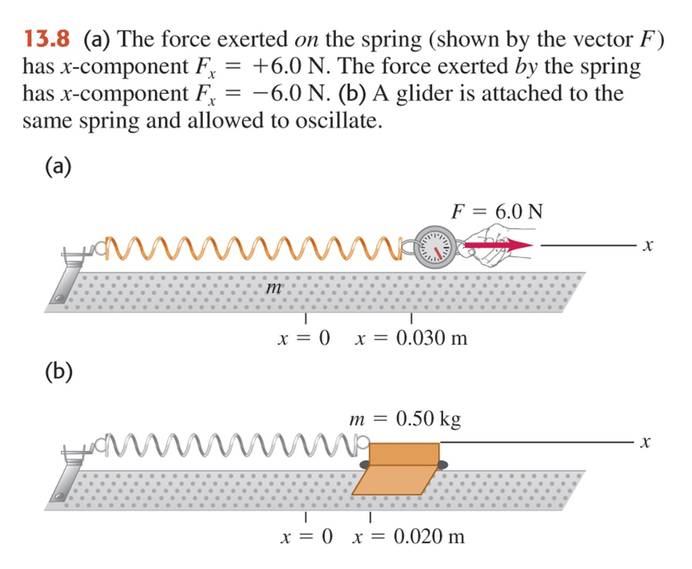
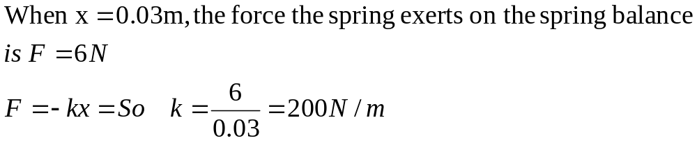
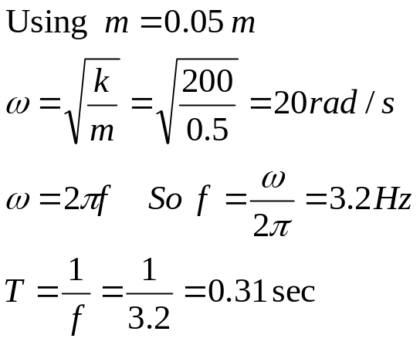
Example13.2 Angular freq, freq and period in SHM
A spring is mounted horizontally, with its left end held stationary . By attaching a spring balance to the free end and pulling toward the right, we determine that the stretching force is proportional to the displacement and that a force of 6.0 N causes a displacement of 0.030 m. We remove the spring balance and attach a 0.50 kg glider to the end, pull it a distance of 0.020 m along a frictionless air track, release it and watch it oscillate.
a) Find the force constant of the spring.
b) Find the angular frequency, frequency, and period of oscillation.

Slide 23
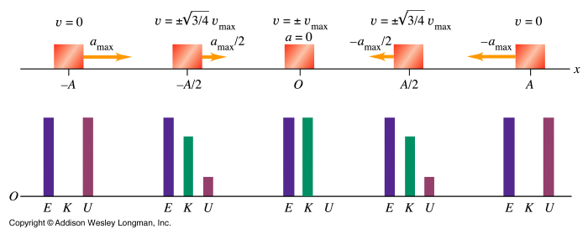
Energy in SHM
In SHM the total mechanical energy E is constant, continually transforming from potential energy U to kinetic energy K and back again

Slide 24
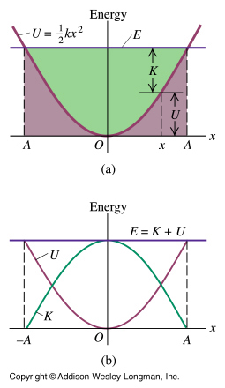
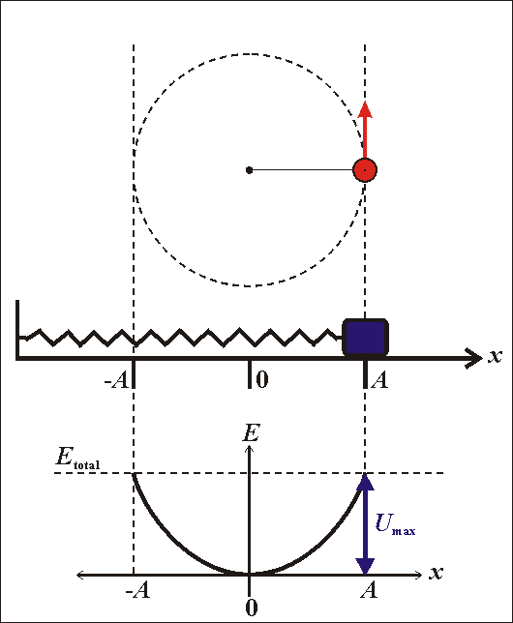
Energy in SHM
Notes:
See notes – another way of looking at energy in SHM and how mechanical energy is conserved, changing from elastic to kinetic

Slide 25


Slide 26
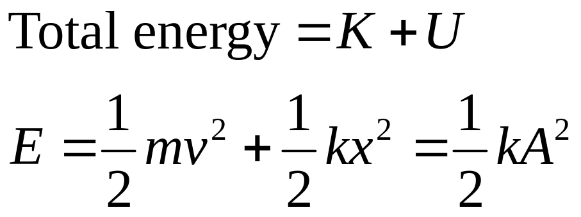
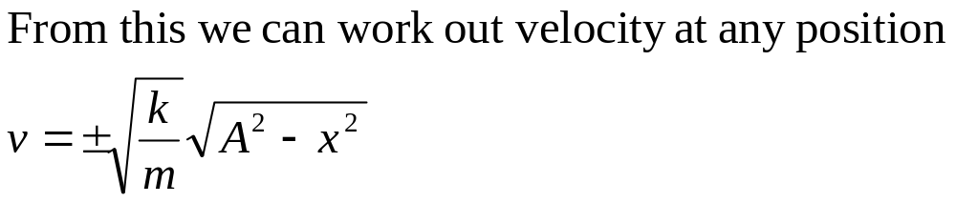
Energy in Simple Harmonic Motion
From this derive an equation for velocity at any position

Slide 27
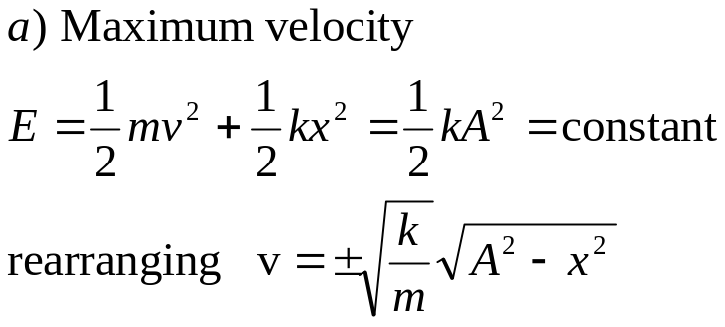
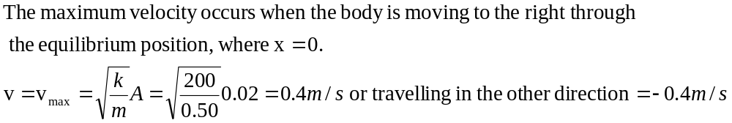
Example 13.4 Mass on spring (cont)
A body with mass 0.50 kg is attached to a spring with a force constant k of 200 N/m. The other end of the spring is attached to a wall. The body is pulled horizontally 0.02 m from the equilibrium position and released.
Find the maximum and minimum velocities attained by the oscillating body
Notes:
Example 13.4

Slide 28
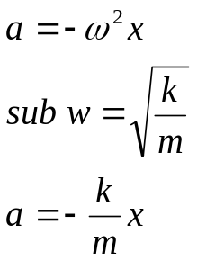
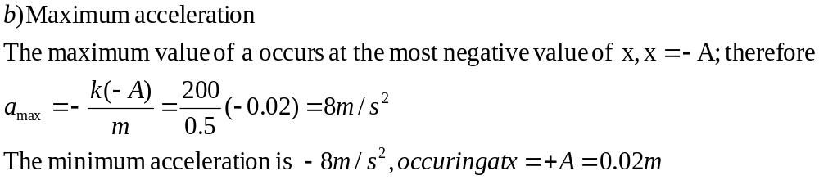
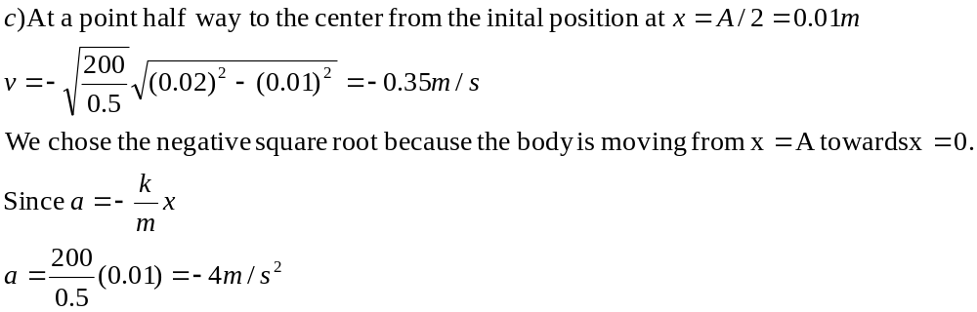
Example 13.4 Mass on spring (cont)
b) Compute the maximum acceleration
c) Determine the velocity and acceleration when the body has moved halfway to the centre from its original position

Slide 29
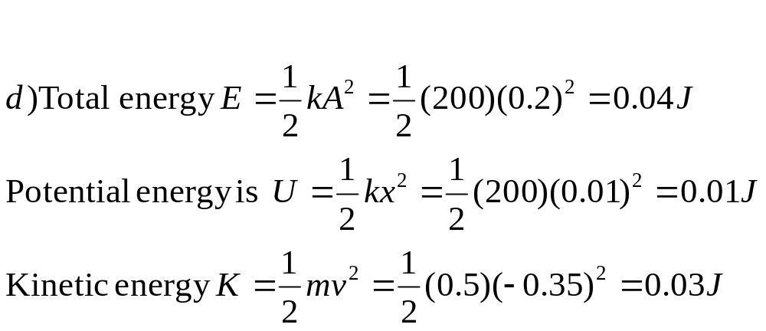
Example 13.4 Mass on spring (cont)
d) Find the total energy, potential energy and kinetic energy at this point x = A/2.

Slide 30

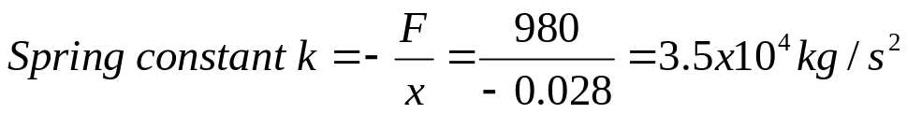
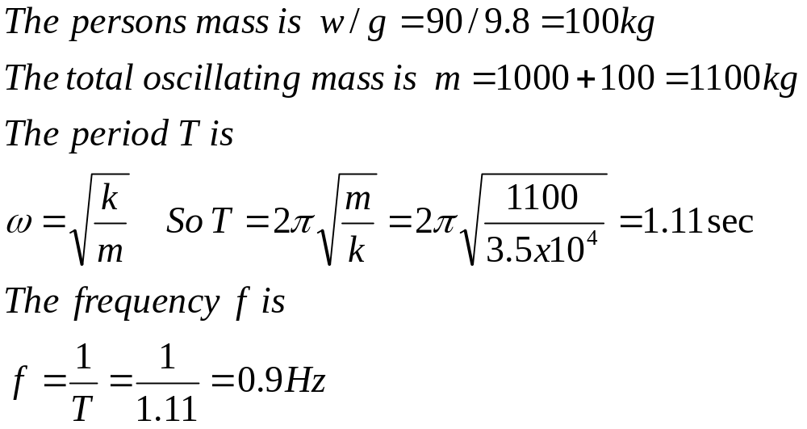
Example 13.6 Vertical SHM in an old car
The shock absorbers in an old car car with mass 1000 kg are completely worn out (therefore little damping). When a 980 N person climbs slowly into the car, the car sinks 2.8 cm. When the car, with the person aboard hits a bump the car starts oscillating up and down in SHM.
Find the period T and frequency f of the oscillation.

Slide 31
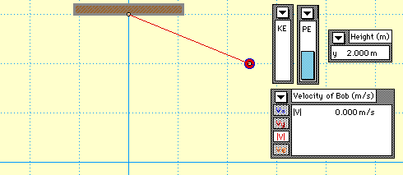
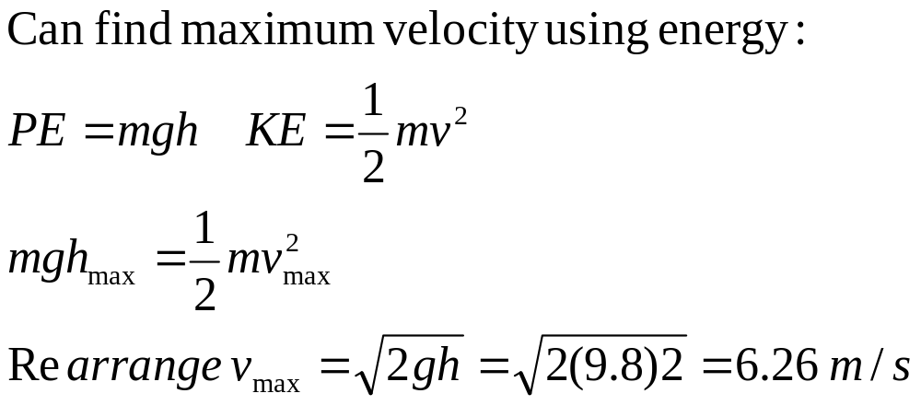
Pendulum-Exhibiting SHM
Find maximum velocity
Notes:
Just as for ordinary motion we first looked at solving problems with the equations of motion for constant accn and then found that we could use energy considerations for more complex situations, we’ve looked at using equations of motion but can also consider energy in SHM to help find solutions to SHM. Particularly useful when not given t. We’ve looked at the energy stored in a spring and we saw that if no nonconservative forces act (ie no friction) then the mechanical energy is conserved. See sheet for rest.

Slide 32


